Slide 1
Anomaly Detection in Traffic Data
Nahush Kolhe
Supervised by Prof. Edward Chung
The Hong Kong Polytechnic University
30th May 2024

Slide 2
Table of Contents
About me & IIT Bombay
Introduction
Methodology
Results
Conclusion

Slide 3
About Me & IIT Bombay
I am Nahush Kolhe, a 3rd year UG in Engineering Physics at IIT Bombay.
Interest in Machine Learning, also pursuing minor in Data Science
Indian Institute of Technology, Bombay (IITB), one of the best engineering college in India.
Entrance exam : JEE Advanced, (2 yearlong preparation)
Several branches : CS, EEE, Aerospace, Physics, Chemical, Metallurgy, etc.
Good research opportunities to work under Professors
Freedom to explore other branches & non-core as well like Finance, Consult etc.

Slide 4
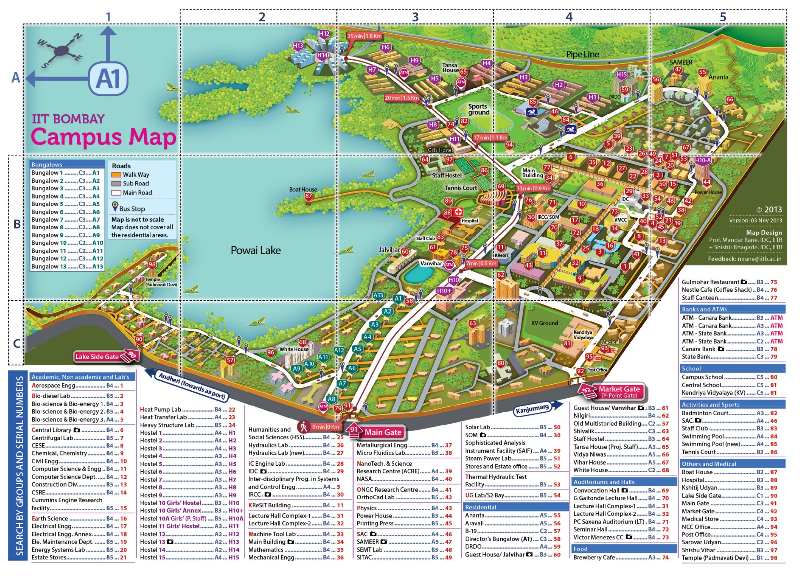
Campus Life
Huge (525 acre), and green campus.
Hostels, Academic area, Residential area, Gymkhana grounds, Student Activity Area, and even a hill!
Everything is student run, like clubs.
Nightlife, especially at canteens.
One of the largest cultural and technical fests in Asia, ‘Mood Indigo’ and ‘Techfest’.
Map of IIT Bombay

Slide 5
Introduction

Slide 6
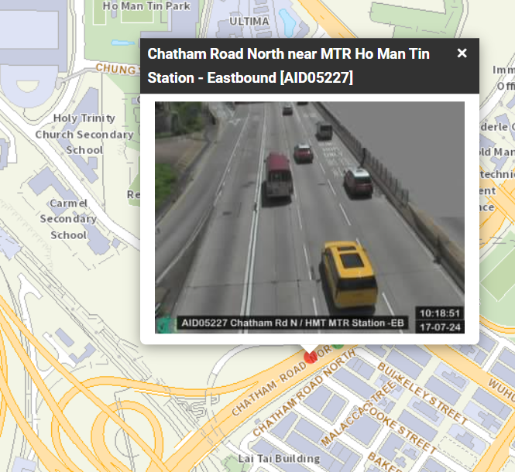
Introduction
Anomaly : is a data point or pattern that significantly deviates from the expected behavior or norm in a dataset.
Role of Detector : Cameras which capture images of traffic and processes it further.
Road Traffic Data : Information about speed, flow, and occupancy of vehicles.
Image captured by detector
(available on www.hkemobility.gov.hk)

Slide 7
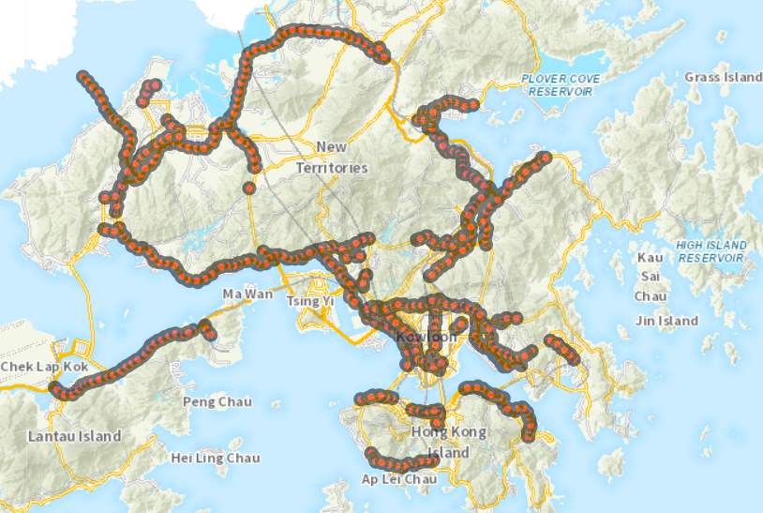
Problem Statement : Automatically detect anomalies in the traffic data for a network of detectors.
We analyse detectors on strategic/major routes of Hong Kong
Why do this ?
1. Identify anomalies to improve data collection.
2. To obtain clean data without anomalies,
which is used further by stakeholders.
Detectors on Major routes of Hong Kong
(available on portal.csdi.gov.hk)

Slide 8
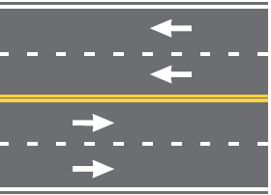
Dataset Description
Obtained from government website (data.gov.hk) of Hong Kong.
6 months data (10/23 - 03/24) for 768 detectors.
Data 1. Contains speed, flow & occupancy for each lane of detector sampled at 2-min frequency
Data 2. Contains Location of all detectors & their bound direction.
Westbound Detector
Location of detectors on major routes
Eastbound Detector

Slide 9
Methodology
1. Correlation between nearby detectors : Identifies evident anomalies, and helps to create training datasets for further methods
2. Profile Model
3. Supervised Classification
Machine Learning Models

Slide 10
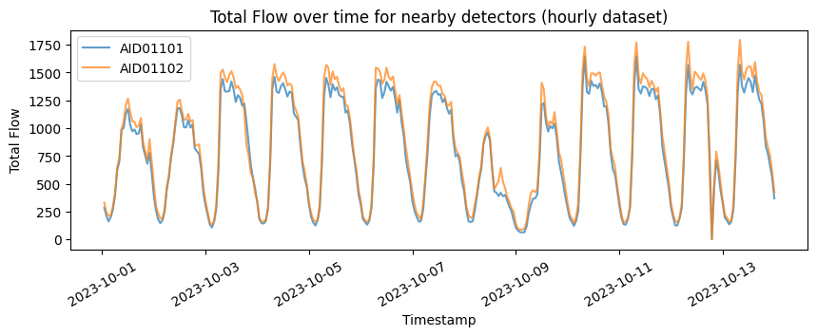
1) Correlation between Nearby Detectors
Nearby detectors along the same road should be highly correlated
Total flow is found to be the best metric to classify anomalies, due to conservation of flow.
Using the location, we can obtain triplets of detectors which should be highly correlated.
Example of nearby detectors being highly correlated (>0.9)
Notes:
Detectors on diverging roads also have high correlation.

Slide 11
Triplets of Detectors
Why triplets : It gives just enough information to identify the data as anomaly or not.
Exploiting the systematic naming of detectors and ensuring that they lie within 1km, we obtain triplets of detectors.
Calculate the correlation within the triplets to identify good data (without anomalies)
A
Correlation value
corr 1 | corr 2 | corr 3
✓ | ✓
✓ | ✗
✗ | ✓
✗ | ✗ | ✓
✗ | ✗ | ✗
Detectors
A | B | C
✓ | ✓ | ✓
✓ | ✓ | ✗
✗ | ✓ | ✓
✓ | ✗ | ✓
✗ | ✗ | ✗
Threshold used is 0.9 for good data
corr > 0.9
corr < 0.9
corr 1
corr 3
B
✓
corr 2
✗
C
Classification for a triplet (A, B, C)
Detectors A,B,C

Slide 12
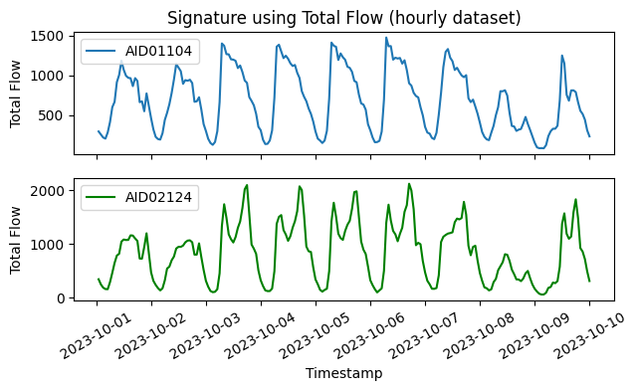
2) Profile Model
It learns the signature of the detector.
Different signature for different detectors.
If the model doesn’t identify the detector by its signature, then its an anomaly
Notes:
Only choose detectors with enough data for training.

Slide 13
2) Profile Model
Machine Learning Classification model (600 classes - for each detector)
Input : 2-min timeseries flow data for a day and expect the model to identify the detector correctly.
Output : Ranks of detectors ( rank 1 = best predicted detector )
Input
Timeseries
Linear
720x128
ReLU
ReLU
Linear
(128+32)x32
Linear
32x128
ReLU
ReLU
ReLU
One hot Day
Linear
7x32
Linear
32x32
Linear
128x600
Output Ranks
Profile Model Architecture

Slide 14
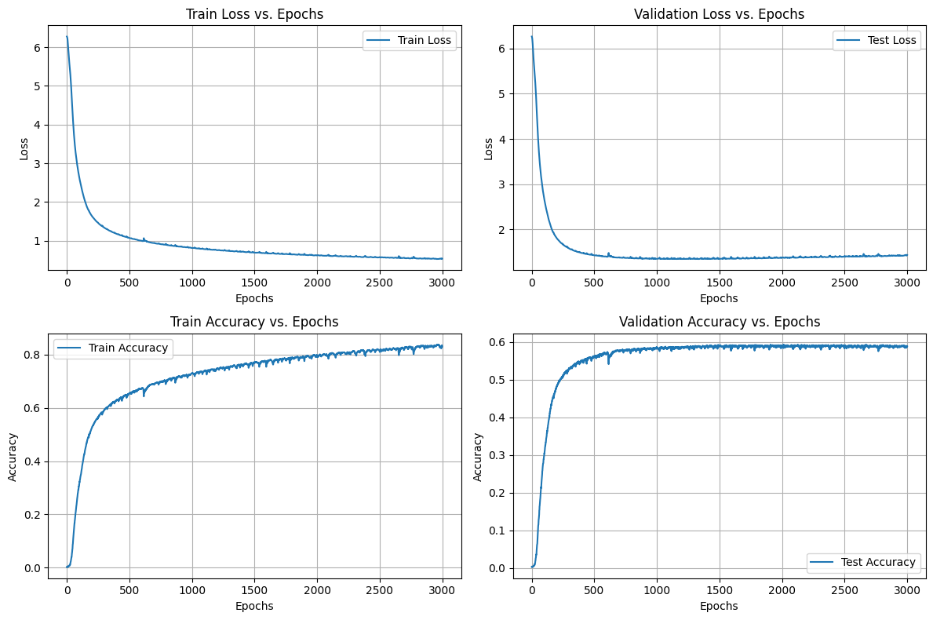
Training Profile Model
We use the triplets to get only the highly correlated (>0.9) data for training.
Remove data which has >5% null values.
Profile Model with Cross-entropy loss.
Optimizer = Adam, lr = 0.001, wd = 0.001
Top 1% Accuracy : Accuracy that correct detector lies in top 1% of the predicted.
Top 1% Accuracy for Test data = 92%

Slide 15
3) Supervised Classification
We use triplet data to find the average correlation of a detector for each day.
Label highly correlated (>0.9) as 1, and very low correlation (<0.7) as 0 (anomaly)
Input for a detector on a day will also contain data from its triplets, and output is the label.
Input
Triplet
Linear
720*3x512
ReLU
Linear
512x128
ReLU
Linear
(128+32)x32
ReLU
Linear
32x8
ReLU
Linear
8x1
One hot Day
Linear
7x32
ReLU
Linear
32x32
ReLU
Anomaly or not

Slide 16
Training the Supervised Model
Classes are heavily imbalanced (only 5 % are anomalies)
For the anomaly case, rearrange to get double the amount of data.
Balanced Cross-Entropy loss (basically weighted based on amount of imbalance)
Optimizer = Adam, lr = 0.001, wd =0.01
A, day3
A, day3
C, day3
B, day3
Augment
B, day3
+
B, day3
C, day3
C, day3
A, day3

Slide 17
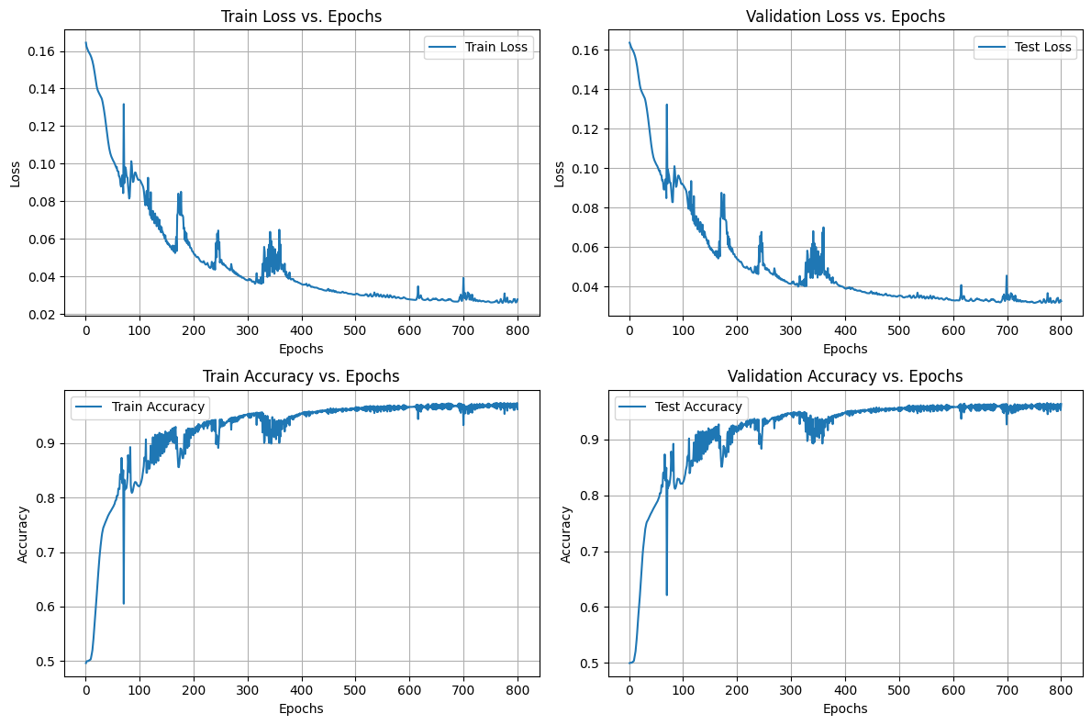
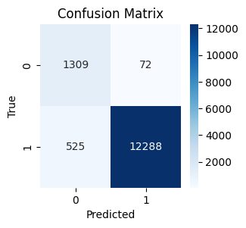
Training results of Supervised Model
Balanced Accuracy for Test data = 96 %
Note: Output is probability hence threshold used is <0.5 is anomaly.
Recall for class ‘0’ = 95%

Slide 18
Results

Slide 19
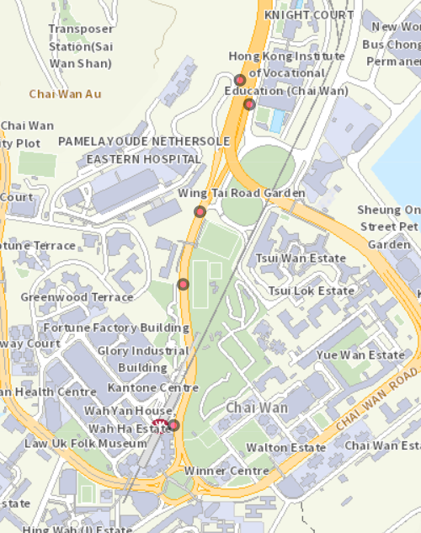
Correlation values
AID04203
corr = 0.87
Here we have calculated the correlation for entire 6 months
Clearly AID04201 seems to be anomaly.
Hence by analysing correlation within triplet we can identify evident anomalies.
AID04202
corr = 0.28
AID04201

Slide 20
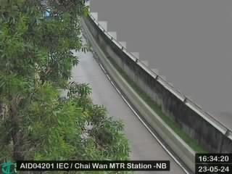
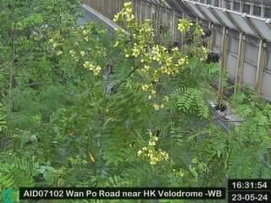
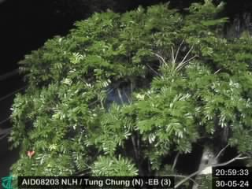
Correlation values
AID04201
AID07102
AID08203
These detectors consistently have extremely low correlation (< 0.4)

Slide 21
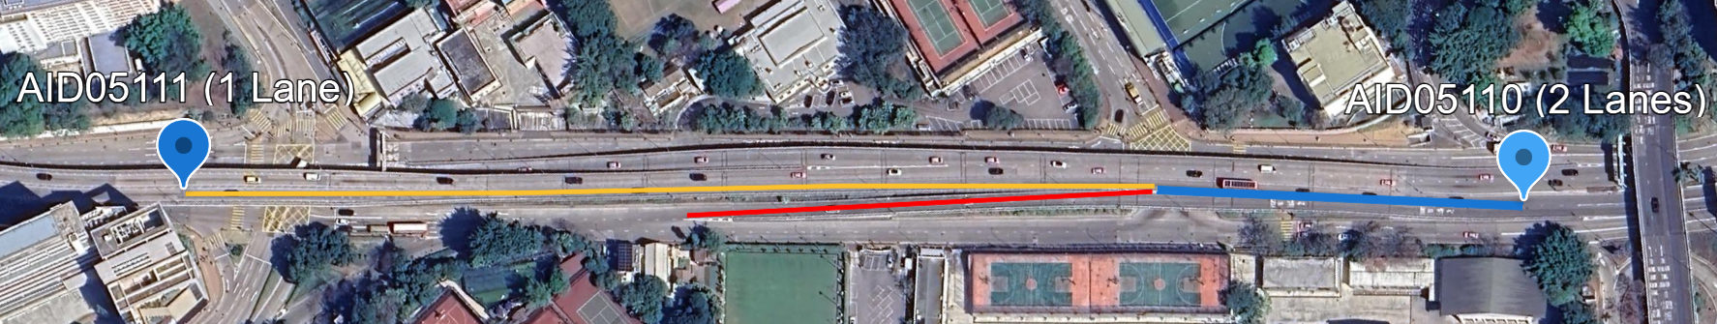
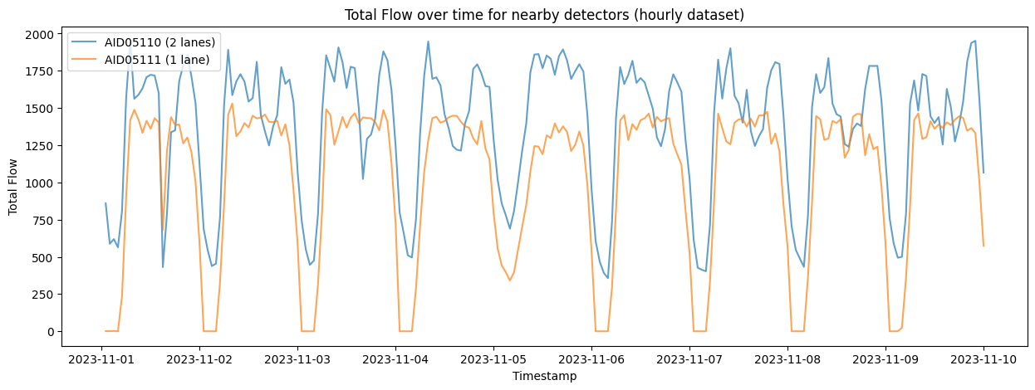
More examples of anomalies
AID05110 (westbound, 2 lanes) : Upstream detector of blue road. AID05111 (westbound, 1 lane) : Downstream detector of yellow road.
The blue road diverges into yellow and red road. We expect the total flow of blue to be greater than yellow at all times, but it gets violated in the graph.
Correlation = 0.78
Anomalies

Slide 22
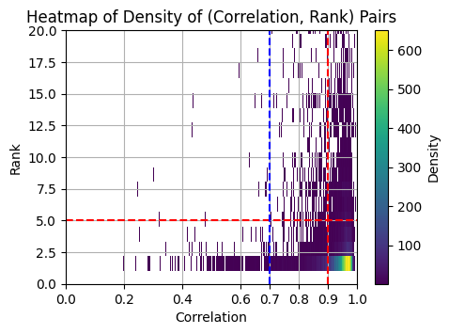
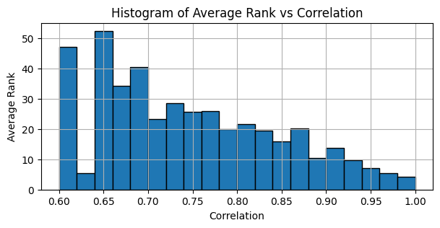
Profile Model vs Correlation
For each day and detector we compare the profile model rank and the corresponding correlation.
We can see that for higher correlation we are more likely to get better rank.

Slide 23
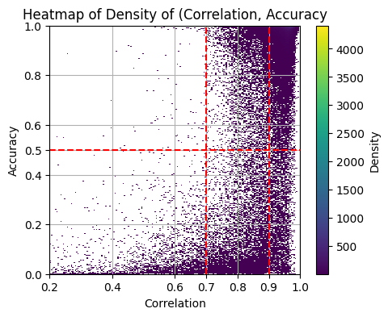
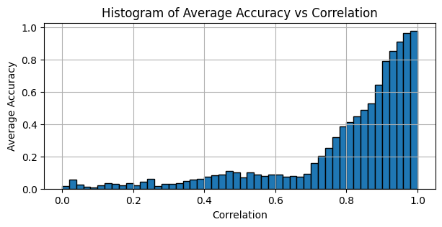
Supervised Model vs Correlation
Similarly we compare the supervised model accuracy with correlation
We can see that as expected higher correlation are more likely to have higher accuracy

Slide 24
Conclusion

Slide 25
Conclusion
If the detector on a particular day has >0.9 correlation, we treat it normal, and if its <0.7 then anomaly.
When the correlation is between 0.7 and 0.9, we take the help of profile model and the supervised model, and combining their results we take the decision.
Using the 3 methods discussed we can automatically detect the anomalies among the network of detectors for that particular day.
Possible future work includes lane-wise analysis, and to exploit speed-flow-occupancy relation.

